Slide 1









My Algebra – Polynomials Interactive Notebook
$$×$$
$$\frac{1}{2}$$
$$÷$$
$$+$$
$$−$$
$$\frac{3}{5}$$
$$7$$
Name
Class
Teacher
Term 2 Semester 1
$$5^{2}$$
$$\sqrt{9}$$

Slide 2
Contents
Glossary or Formula Page
Page
Date
Description
2

Slide 3
Tasks
24
7
30
Essential Question
Questions
Notes
Summary
6

Slide 4
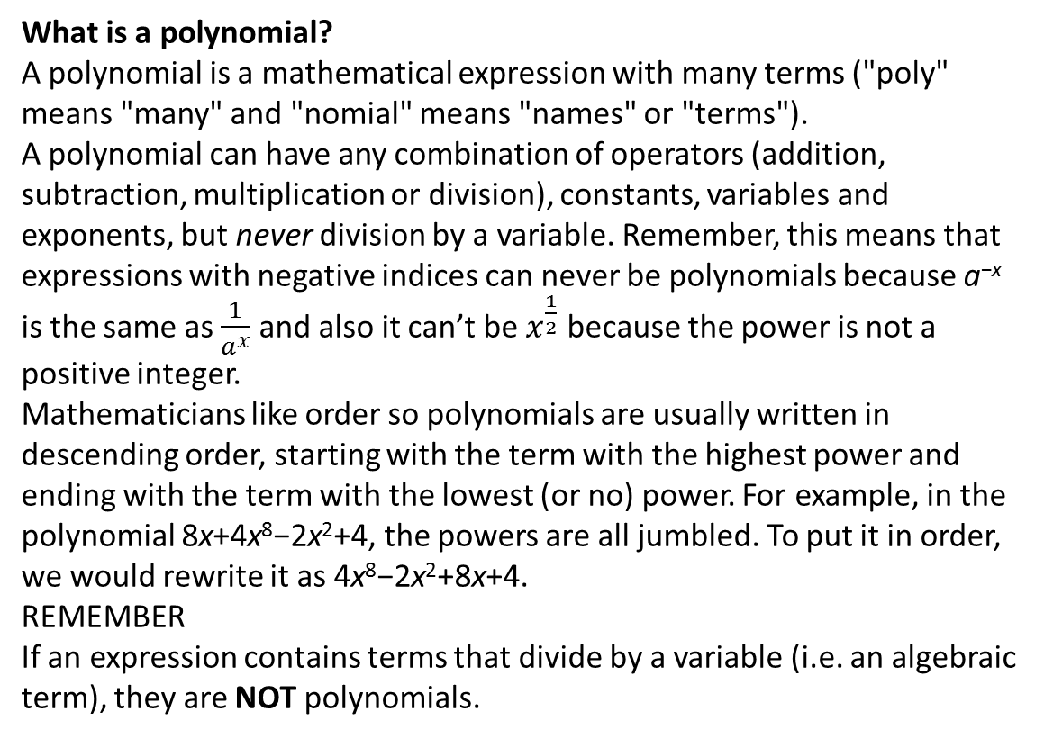
24
7
30
Date
Polynomials?
EQ – What is a Polynomial – A Function with lots of Terms!
What is a polynomial?
A polynomial is a mathematical expression with many terms ("poly" means "many" and "nomial" means "names" or "terms").
A polynomial can have any combination of operators (addition, subtraction, multiplication or division), constants, variables and exponents, but never division by a variable. Remember, this means that expressions with negative indices can never be polynomials because a^{−x} is the same as $\frac{1}{a^{x}}$​ and also it can’t be $x^{\frac{1}{2}}$ because the power is not a positive integer.
Mathematicians like order so polynomials are usually written in descending order, starting with the term with the highest power and ending with the term with the lowest (or no) power. For example, in the polynomial 8x+4x⁸−2x²+4, the powers are all jumbled. To put it in order, we would rewrite it as 4x⁸−2x²+8x+4.
REMEMBER
If an expression contains terms that divide by a variable (i.e. an algebraic term), they are NOT polynomials.

Slide 5
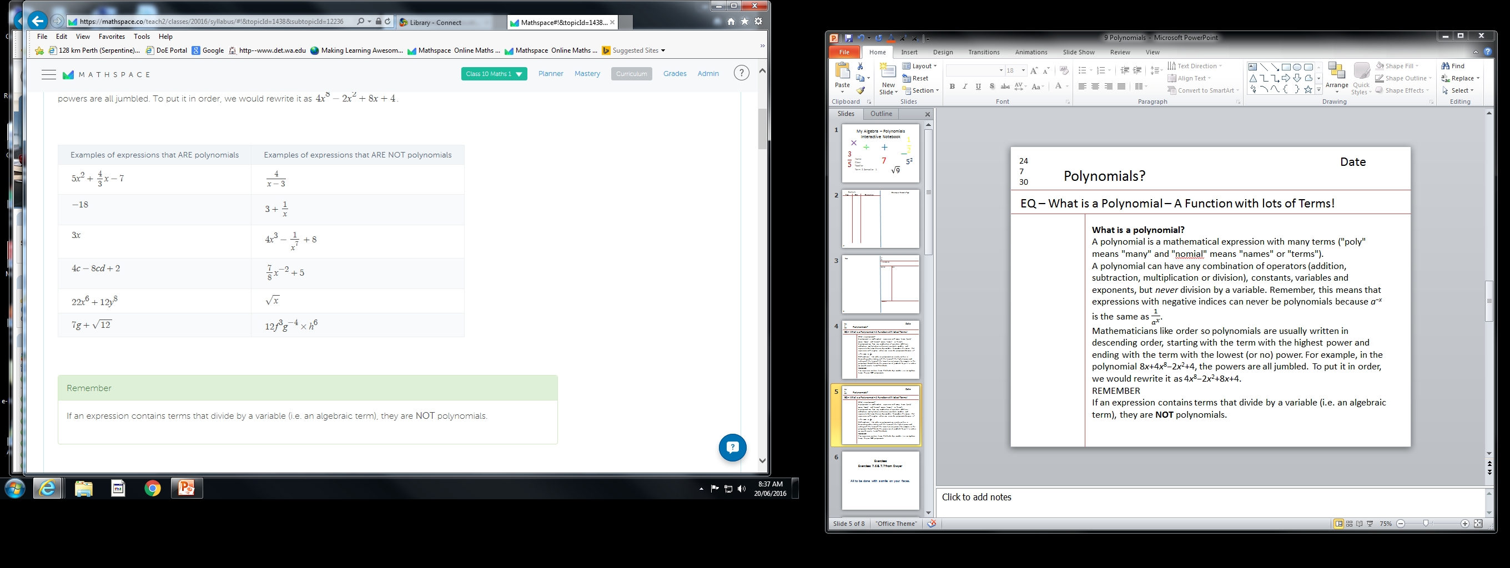
24
7
30
Date
Polynomials?
EQ – What is a Polynomial – A Function with lots of Terms!
Why are the left column polynomials and right column not?

Slide 6
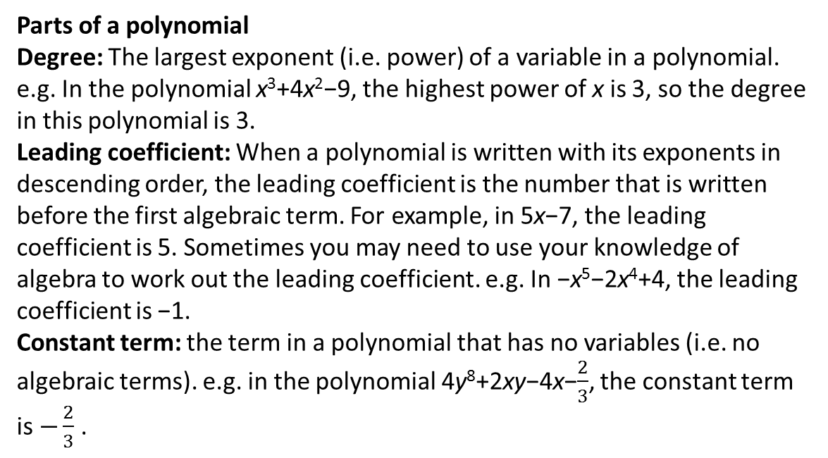
24
7
30
Date
Polynomials?
EQ – What is a Polynomial – A Function with lots of Terms!
Parts of a polynomial
Degree: The largest exponent (i.e. power) of a variable in a polynomial. e.g. In the polynomial x³+4x²−9, the highest power of x is 3, so the degree in this polynomial is 3.
Leading coefficient: When a polynomial is written with its exponents in descending order, the leading coefficient is the number that is written before the first algebraic term. For example, in 5x−7, the leading coefficient is 5. Sometimes you may need to use your knowledge of algebra to work out the leading coefficient. e.g. In −x⁵−2x⁴+4, the leading coefficient is −1.
Constant term: the term in a polynomial that has no variables (i.e. no algebraic terms). e.g. in the polynomial 4y⁸+2xy−4x−$\frac{2}{3}$​, the constant term is $−\frac{2}{3}$​.

Slide 7
24
7
30
Date
Polynomials?
EQ – What is a Polynomial – A Function with lots of Terms!
Describing Polynomials
We may also be asked to describe features of the function resulting from the sum or difference of two polynomials, so it's important that we're familiar with the features of functions.
Here is a quick summary:
A linear polynomial is the equation of a straight line, which can be written in the form f(x)=mx+b.
A quadratic polynomial is the equation of a parabola, which can be written in the form f(x)=ax²+bx+c.
A cubic polynomial, which can be written in the form f(x)=ax³+bx²+cx+d.
A quartic polynomial, which can be written in the form f(x)=ax⁴+bx³+cx²+dx+e.

Slide 8
Exercises
Exercise 9.1 from Dwyer
All to be done with a smile on your faces.

Slide 9
24
7
30
Date
Polynomials?
EQ – How do we add Polynomials!
Adding & Subtracting Lots of Terms
Adding and subtracting polynomials may sound complicated but it's just the same process as simplifying algebraic expression and equations.
REMEMBER
Just like with any algebraic expression, we can only add and subtract like terms.
The Process
Let's run through the process by looking at an example. Let's say I want to firstly add then find the difference between these two polynomials: P(x)=7x³+4x²−4 and Q(x)=7x³+8x²−2x−8.

Slide 10
24
7
30
Date
Polynomials?
EQ – How do we add Polynomials!
P(x) + Q(x)= 7x³+4x²−4 + (7x³+8x²−2x−8)
Collect the like terms, taking any negative symbols into account. Remember if there is a term with no corresponding term in the other polynomial, you can treat this as a value of zero. For example, P(x) does not have a value of x² but Q(x) does.
We can do it in the form of a table (see eg in text) or by collecting like terms
P(x) + Q(x)= 7x³+7x³+4x²+8x²−2x-4-8
P(x) + Q(x)= 14x³+12x²−2x-12
P(x) + Q(x)= 7x³+4x²−4 + 7x³+8x²−2x−8
P(x) + Q(x)= 14x³+12x²−2x-12
Adding
Don’t forget the answer starts with P(x) + Q(x)=
If you want to leave them in the same place you might want to strike through the ones you have added, as you go.

Slide 11
24
7
30
Date
Polynomials?
EQ – How do we Subtract Polynomials!
P(x) + Q(x)= 7x³+4x²−4 - (7x³+8x²−2x−8)
Collect the like terms, taking any negative symbols into account. Remember if there is a term with no corresponding term in the other polynomial, you can treat this as a value of zero. For example, P(x) does not have a value of x² but Q(x) does.
We can do it in the form of a table (see eg in text) or by collecting like terms
P(x) + Q(x)= 7x³-7x³+4x²-8x²+2x-4+8
P(x) + Q(x)= 0x³ - 4x² + 2x + 4
P(x) + Q(x)= - 4x² + 2x + 4
P(x) + Q(x)= 7x³+4x²−4 - 7x³ - 8x² + 2x + 8
P(x) + Q(x)= 0x³ + 4x² + 2x + 4
P(x) + Q(x)= - 4x² + 2x + 4
Subtracting
Don’t forget the answer starts with P(x) + Q(x)=
0x³ not needed
If you want to leave them in the same place you might want to strike through the ones you have added, as you go.

Slide 12
Exercises
Exercise 9.2 & 9.3 from Dwyer
All to be done with a smile on your faces.

Slide 13
Notes Review
24, 7 ,30
Date
Title
Essential question
Notes complete
Notes complete with colour and diagrams
Questions completed
Contents page filed in
Formula page filled in

Slide 14
Homework
Review your notes and write a summary answering the essential question.

